Slide 1



INTELLIGENT GARBAGE CLASSIFICATION USING DEEP LEARNING
Project Based Experience Learning Program
SRI VENKATESWARA COLLEGE OF ENGINEERING

Slide 2
Project Submitted By :
TEAM LEADER : YERVA POOJITHA
TEAM MEMBERS :
DHAMAKUNTLA HAMEEDA
CELINAJEBA KUMARI V
BUCHIREDDY GARI VEERA KUMAR REDDY

Slide 3
DISCUSSING FACTORS :
PROJECT OBJECTIVES
PROJECT FLOW
PROJECT STRUCTURE
PREREQUISITES
PRIOR KNOWLEDGE
DATA COLLECTION
IMAGE PREPROCESSING
MODEL BUILDING
APPLICATION BUILDING

Slide 4
PRE-REQUISITES :
In order to develop this project we need to install the following software/packages:
Anaconda Navigator :
Anaconda Navigator is a free and open-source distribution of the Python and R programming languages for data science and machine learning-related applications.
It can be installed on Windows, Linux, and macOS.Conda is an open-source, cross-platform, package management system.
Anaconda comes with so very nice tools like JupyterLab, Jupyter Notebook,QtConsole, Spyder, Glueviz, Orange, Rstudio, Visual Studio Code. For this project, we will be using a Jupyter notebook and Spyder.

Slide 5
Python packages: NumPy: NumPy is a Python package that stands for 'Numerical Python. It is the core library for scientific computing, which contains a powerful n-dimensional array of objects. Pandas: pandas is a fast, powerful, flexible, and easy-to-use open-source data analysis and manipulation tool, built on top of the Python programming language. Matplotlib: It provides an object-oriented API for embedding plots into applications using general-purpose GUI toolkits Keras: Keras is an open-source library that provides a Python interface for artificial neural networks. Keras acts as an interface for the TensorFlow library. Up until version 2.3, Keras supported multiple backends, including TensorFlow, Microsoft Cognitive Toolkit, R, Theano, and PlaidML.

Slide 6
PRIOR KNOWLEDGE :
You for developing web applications.ou must have prior knowledge of following topics to complete this project.
Deep Learning Concept :
Deep learning is part of a broader family of machine learning methods, which is based on artificial neural networks with representation learning. The adjective "deep" in deep learning refers to the use of multiple layers in the network. Methods used can be either supervised, semi-supervised or unsupervised.
CNN :
A convolutional neural network (CNN or ConvNet) is a network architecture for deep learning that learns directly from data. CNNs are particularly useful for finding patterns in images to recognize objects, classes, and categories. They can also be quite effective for classifying audio, time-series, and signal data.
Flask:
Flask is a popular Python web framework, meaning it is a third-party Python library used.

Slide 7
PROJECT FLOW :
The user interacts with the UI (User Interface) to choose the image.
The chosen image analyzed by the model which is integrated with flask application.
CNN Models analyze the image, then prediction is showcased on the Flask UI.
To accomplish this, we have to complete all the activities and tasks listed below
Data Collection.

Slide 8
Model Building : 1.Import the model building Libraries 2.Initializing the model 3.Adding Input Layer 4.Adding Hidden Layer 5.Adding Output Layer 6.Configure the Learning Process 7.Training and testing the model 8.Save the Model Application Building : 1.Create an HTML file 2.Build Python Code

Slide 9
PROJECT STRUCTURE :
Create a Project folder which contains files as shown below
project structure
The Dataset folder contains the training and testing images for training our model.
We are building a Flask Application that needs HTML pages stored in the templates folder and a python script app.py for server side scripting
we need the model which is saved and the saved model in this content is a Garbage1.h5
templates folder contains base.html,index.html pages.

Slide 10
DATA COLLECTION :
Collect images of Garbage then organized into subdirectories based on their respective names as shown in the project structure.Create folders of types of Garbage that need to be recognized.
In this project, we have collected images of 6 types of Garbage like CardBoard ,Paper,Plastic,
Glass, Trash & Metal and they are saved in the respective sub directories with their respective names.
This paper is focused on detecting and classification garbage using Deep Learning and Neural Network algorithms. CNN algorithm is used, applied, and analyzed. Confusion matrix and ROC curve are also used. Here in this paper, two different datasets are used, one dataset was available online, and another dataset was built on our own.

Slide 11
IMAGE PROCESSING : In this milestone we will be improving the image data that suppresses unwilling distortions or enhances some image features important for further processing, although perform some geometric transformations of images like rotation, scaling, translation, etc.
Steps involved in the image processing :
Import the image Data Generator Library.
Configure Image Data Generator Class .
Apply Image Data Generator Functionality To Trainset And Testset.

Slide 12
MODEL BUILDING :
Now it's time to build our Convolutional Neural Networking which contains an input layer along with the convolution, max-pooling, and finally an output layer.
Importing the model building libraries.
Intializing the Model.
Adding CNN Layers.
Configure the Learning Process.
Train the Model.
Save the Model.
Test the Model.

Slide 13
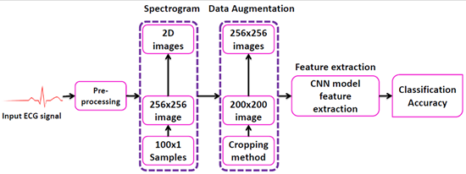

Slide 14
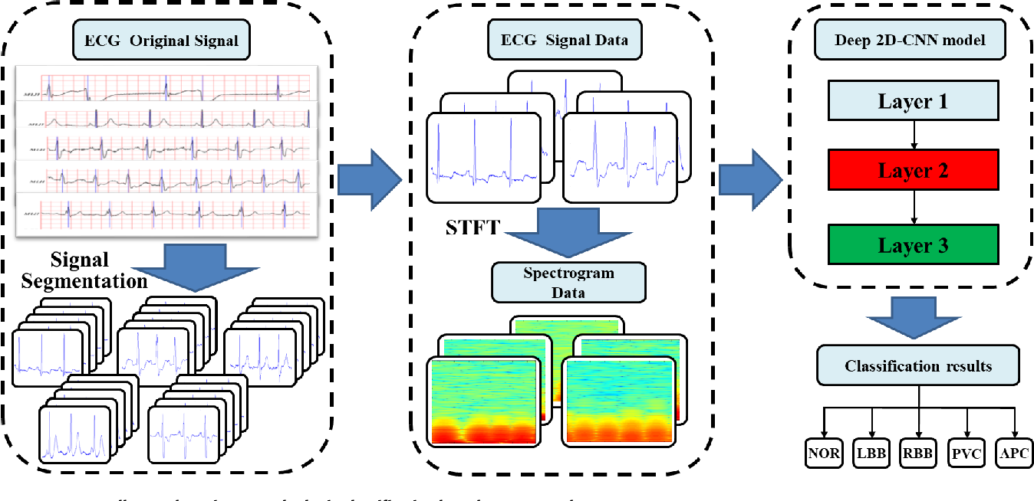

Slide 15
APPLICATION BUILDING :
Now that we have trained our model, let us build our flask application which will be running in our local browser with a user interface.
In the flask application, the input parameters are taken from the HTML page These factors are then given to the model to know to predict the type of Garbage and showcased on the HTML page to notify the user. Whenever the user interacts with the UI and selects the “Image” button, the next page is opened where the user chooses the image and predicts the output.

Slide 16
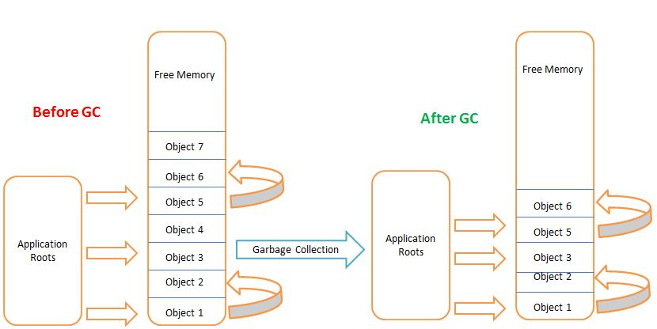
Create HTML Pages.
Build Python Code.
Run the Application.

Slide 17

THANK YOU

